Slide 1
Covid-19 Recovery Plan: Safely Returning to the Courthouse

Slide 2
Projected COOP Termination Date: Monday, June 1, 2020
What does this mean
for you?
The present COOP activation Standing Order 20-10, will not be extended.
Effective Monday, June 1, 2020, the court will begin slowly and safely phasing you back to work.
We are committed to ensuring that this process is done with your well-being as the primary focus.
Notes:
Standing order

Slide 3
PHASES TO RECOVERY
PHASE ONE
Strict social distancing and geographic isolation.
Strict exposure control when in the courthouse.
Strict six foot social distancing and group sizes of no more than ten people.
Maximum flexibility with telework.

Slide 4
PHASE TWO
Continue same criteria as phase one but to the greatest extent possible. Increase in on-site court proceedings.
PHASE THREE
Lessen restrictions further.
PHASE FOUR
Represents a full unrestricted return to normal operations and activities.

Slide 5
Phase One: Limited Operations
In-Court Proceedings: May be scheduled sparingly and with great care.
Jury trials, petty offense docket and in-person settlement conferences are not considered to be in phase one.
To the extent possible. Courtroom sharing should be avoided on the same day.
A 20 minute break should be scheduled between each proceeding to give time to clear courtroom and observe cleaning protocols.
Prior to June 1, we will provide masking protocols for the phase one in-court proceedings.
Participants who arrive early for their appointed court session will be staged outside of the courtroom.

Slide 6
Phase One: Limited Operations (Cont.)
Persons who satisfy one or more of the following criteria should not report to work:
• Persons subject to, living with, or caring for an individual who is subject to a Federal, State, or local quarantine or isolation order related to COVID-19.
Human Resources Considerations:
• Persons advised by a health care provider to self-quarantine due to concerns related to COVID-19 or living with or caring for an individual who has been advised to self-quarantine.
• Persons considered “high risk” or living with or caring for an individual who is considered “high risk” where local health officials recommend such individuals remain at home due to concerns related to COVID-19.
• Persons experiencing symptoms of COVID-19 and seeking a medical diagnosis or living with or caring for an individual who is experiencing symptoms of COVID-19 and seeking a medical diagnosis.
• Persons caring for a child if the school or place of care of the child has been closed, or the childcare provider of such child is unavailable due to COVID-19 precautions.

Slide 7
Phase One: How will court coverage assignments be made?
Goal:
Adequate coverage. Safely phased-in…
Staffing of Chambers will be at the discretion of the Judge.
Clerk’s office staff will be phased in on a rotational basis by each supervisor with consideration given to personal circumstances. Mail opening, receipt writing and order processing are considered essential functions.
Full-time in-court schedules are not anticipated and telework will remain the norm.

Slide 8
Phase One: Keeping you safe in the office
Protocols
and
Best Practices

Slide 9
YOU are key to keeping all of us safe

Slide 10
Social Distancing Protocol
6 feet distance from others.
Eliminate physical contact such as handshakes or hugs.
Avoid touching surfaces touched by others.
Avoid anyone who appears to be sick, or who is coughing or sneezing.

Slide 11
Personal Protective Equipment (PPE) Protocol
Masks/face coverings: NOT REQUIRED in private work areas provided sufficient physical distancing from others.
Masks/face coverings: REQUIRED in common areas of courthouse (elevators, hallways, entryways, lunchrooms, etc.), regardless of whether other people are present or walking past.
Visitors: Masks/face covering REQUIRED in all common or public areas of the courthouse, including the clerk’s office.
PPE: Disposable masks, disposable gloves, hand sanitizers and any other necessary PPE will be amply available in each vicinage.

Slide 12
Disinfection Protocols
Upon entering office: All staff must immediately wash or sanitize hands.
Staff must wipe their door knobs, light switches and work station areas, throughout the work day.
Staff must wipe common surfaces before and after use (kitchen counter, work counter, door knobs, etc.).
Disinfectant stations/hand sanitizer. Will be provided on each floor by GSA.

Slide 13
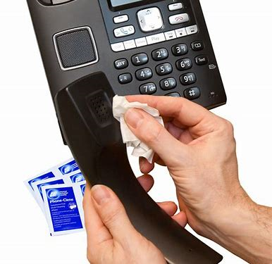
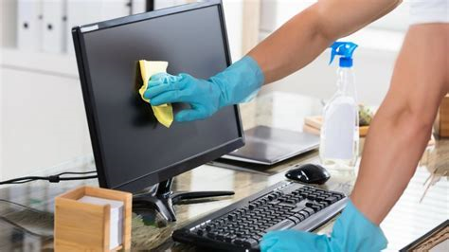
Work Stations
Do not share work space with other staff.
If emergency requires use of other staff area and equipment: Wipe all surfaces before and after.

Slide 14
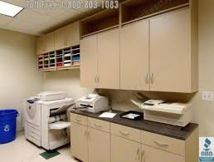
The other areas…
Shared Office Equipment:
Copiers, scanners, common workstations and keyboards: Must be wiped down with a disinfectant wipe after each use.
Common Telephones: Shall also be disinfected after each use.
Bottom Line: Wipe down all surfaces touched.

Slide 15
Protocols for Common Areas
Break Room/Lunch Room: All surfaces contacted shall be wiped down after use.
Staff choosing to use refrigerators, coffee maker/kitchen equipment/counter space must disinfect all surfaces touched before and after use.
Conference rooms: OPEN with limited occupancy. Max. occupancy will be posted on doors of all shared space but will be limited to strict physical distancing protocols. Masks/face coverings are required when using conference rooms.

Slide 16
MDPA Protocols for Symptomatic or Covid-19 Positive staff: Everything you need to know.

Slide 17
MDPA Covid-19 Human Resources Specialist: Debbie Skopek Role and Responsibilities
What is the Covid-19 Human Resources Specialist’s role?
All interactions will be completely confidential.
Staff shall report to Ms. Skopek if they are experiencing Covid-19 symptoms and/or have a positive COVID-19 tests. Phone: (570) 207-5670 Email: Deborah_Skopek@pamd.uscourts.gov
Complete Covid-19 Case Form.
Implement District Court contact tracing procedures.
Debrief daily with Chief Judge or Clerk of Court.

Slide 18
Staff Responsibilities
IF temperature >100.4 OR exhibiting other signs of COVID-19 infection per CDC guidance, staff member shall:
Stay Home.
Self-report to Covid-19 Human Resources Specialist.
Call physician and seek Covid-19 testing ASAP.
https://www.cdc.gov/coronavirus/2019-ncov/symptoms-testing/symptoms.html

Slide 19
Staff responsibilities (Cont.)
Symptoms while in the office: Immediately notify a supervisor or Clerk of Court via telephone. You will be sent home. The Covid-19 Human Resources Specialist will contact you and complete a Covid-19 case form.
Staff members may NOT return to work until they have met the *CDC criteria to discontinue home isolation and have consulted with a healthcare provider or local health department.
* https://www.cdc.gov/coronavirus/2019-ncov/hcp/disposition-in-home-patients.html

Slide 20
Will the office close if someone is suspected or confirmed to be Covid-19 positive?
In most cases, CDC does not recommend closure.
Ill staff members’ work space will be closed off and untouched for 24 hours.
After 24 hour wait period, the work area will be cleaned and disinfected per CDC guidelines.

Slide 21
MDPA Contact Tracing Procedures:
Will I know if someone I work with is Covid-19 positive?
Yes. If a staff member is confirmed to have COVID-19, the Covid-19 Human Resources Specialist will notify those co-workers who were in “close contact” with an infected person per CDC guidelines.
What about my privacy?
The Covid-19 Human Resources Specialist will notify all staff members who were in “close contact” with a symptomatic Covid-19 person. As required by the Americans with Disabilities Act (ADA), confidentiality will be maintained unless the staff member requests otherwise.

Slide 22
POINTS TO REMEMBER:
This is the view from May 22nd.
Expect adjustments as we move forward.
We are committed to operating safely and well as we begin the process of phasing back to full operations in the coming weeks and months ahead.

